Slide 1
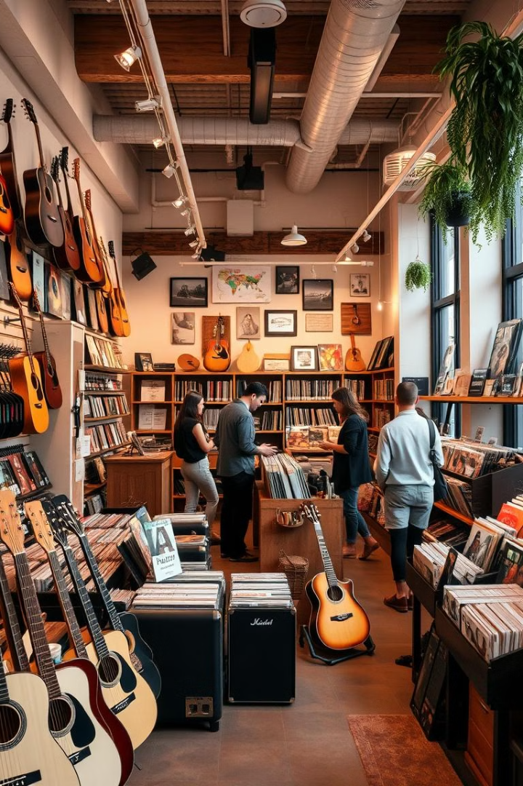
Chinook Music Store: Customer Insights & Sales Analysis
This presentation explores customer data and sales trends for Chinook Music Store, providing insights into customer behaviour, market performance, churn trends and opportunities for growth.
Presented by Anchal Rani Barnowal

Slide 2
Data Quality & Handling
Missing Values
Handling Nulls
Column Dropping
Default Values
Two tables, Customer and Track, contain null values.
Replaced null values in Track's Composer column with 'Unknown'.
Dropped Company and Fax columns due to high null counts.
Updated remaining columns with default values: State - Unknown, Postal Code - 0, Phone - Not Provided.

Slide 3
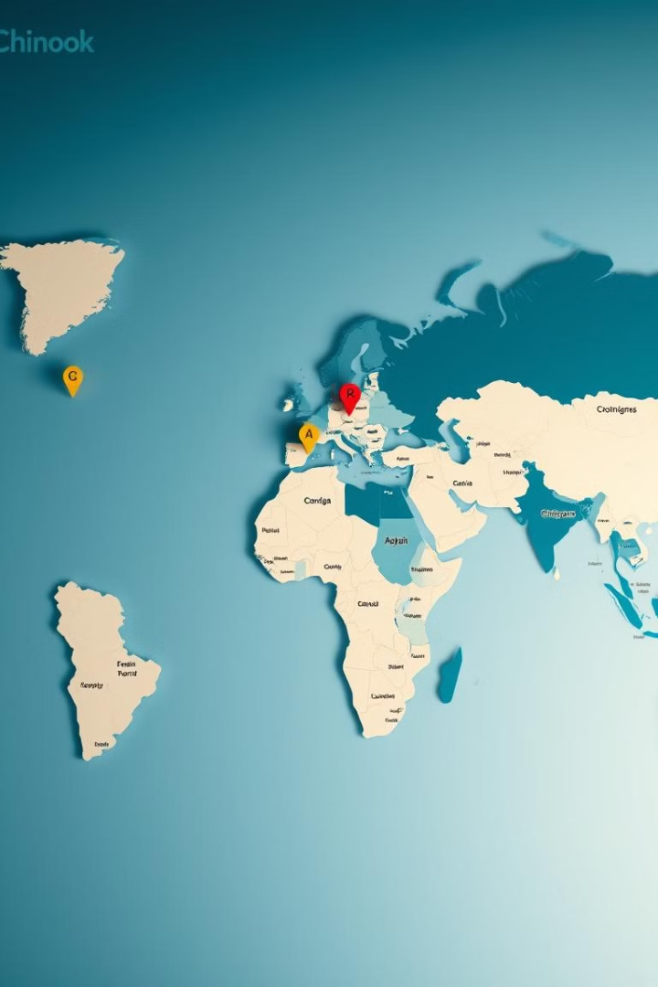




Customer Demographics
USA
Canada
Brazil & France
13 customers, the highest concentration.
8 customers, second highest.
5 customers each.
Other Regions
Customers distributed across Europe, South America, and other regions.

Slide 4
Market Presence
Global Reach
Key Markets
Chinook customers are spread across multiple countries, with the highest concentration in the USA, followed by Canada, Brazil, and France.
North America (USA & Canada) are Chinook's strongest markets, with a presence in Europe, South America, and other regions.

Slide 5
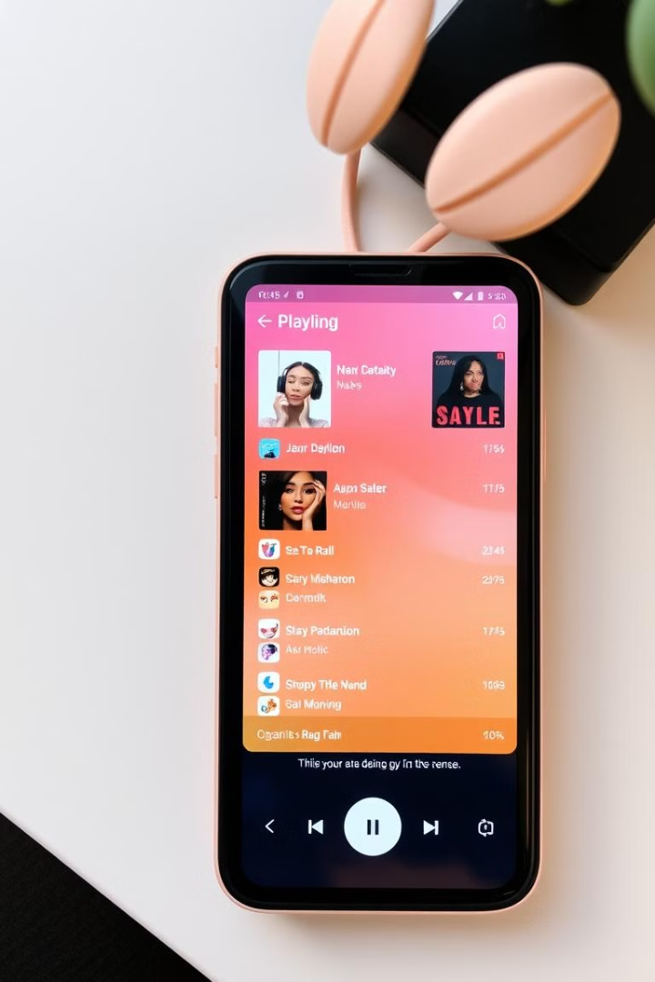
Top-Selling Tracks & Genres
1
Rock Dominance
2
Alternative & Metal
Rock is the best-selling genre worldwide, contributing over 50% of sales in the USA.
Alternative & Punk and Metal are also popular, accounting for over 75% of sales in the USA.
3
Queen Reigns Supreme
Queen is the top-selling artist globally, showcasing their enduring appeal.
4
Niche Genres
Jazz, Easy Listening, and Reggae have smaller but dedicated audiences, while Classical, Heavy Metal, and Soundtrack have limited sales.

Slide 6
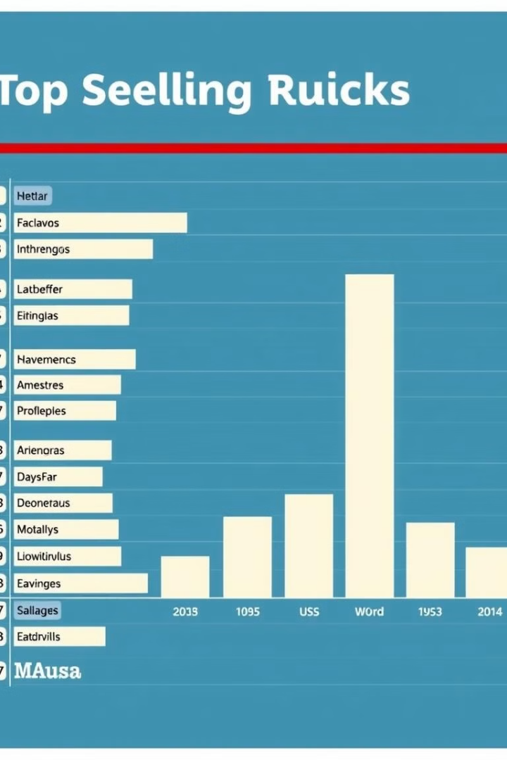
Top-Selling Tracks & Artists in the USA
1
Top Track
2
Genre
War Pigs by Cake, generating $5.94 in revenue.
War Pigs falls under the Alternative genre.
3
Insights
Highlights the popularity of Alternative music among US customers.

Slide 7
Revenue & Invoice Analysis
Top-Performing Countries
Key Cities
Strong Canadian Activity
European Markets
Mountain View (CA), Redmond (WA), Fort Worth (TX) in the USA; São Paulo and São José dos Campos in Brazil.
Dublin (Ireland), Amsterdam (Netherlands), and Rome (Italy) contribute significantly.
USA and Brazil lead in revenue and transaction volume.
Montréal and Ottawa are top revenue-generating cities in Canada.

Slide 8
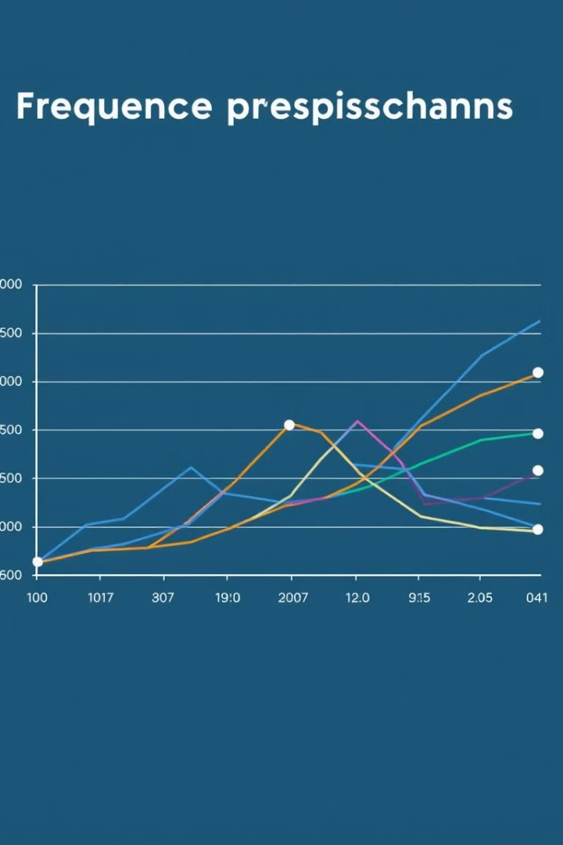
Customer Purchasing Behavior
1
Purchase Frequency
Some customers make frequent purchases, while others are less frequent.
2
Average Order Value
Most customers have an average order value of $0.99, suggesting individual item purchases.
3
Spending Patterns
Higher total purchase values correlate with more frequent purchases.
4
Customer Segments
Frequent buyers with smaller, regular purchases and occasional buyers making larger purchases.

Slide 9
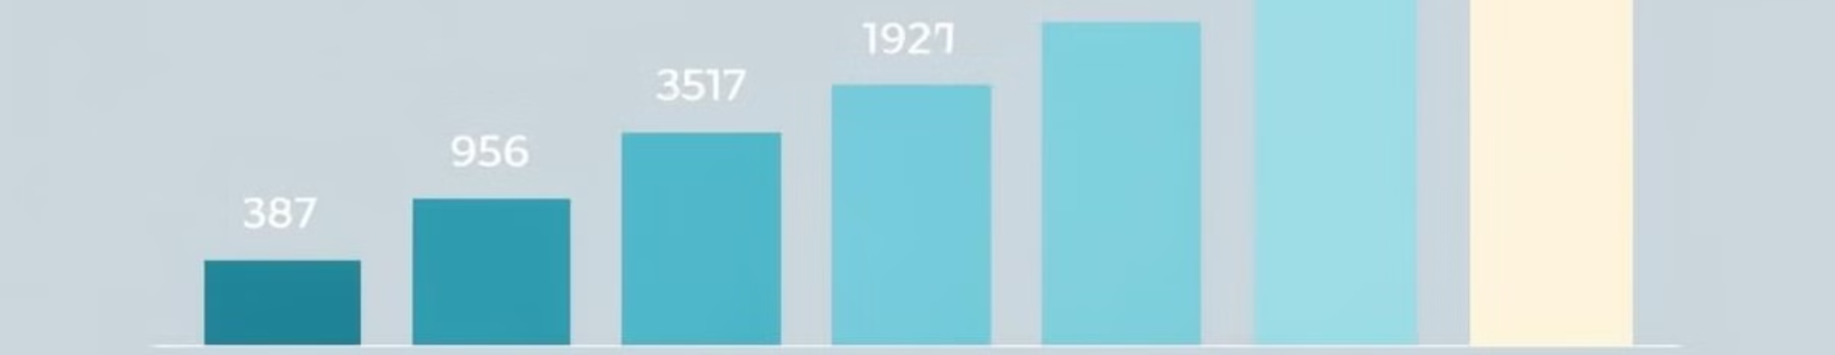
Customer Churn Rate
3.51%
1.82%
-7.41%
2017
2018
2019
Churn rate declined from 2017 to 2018.
Negative churn in 2019 indicates growth and potential increase in brand loyalty.
To further reduce churn, consider loyalty programs, personalized promotions, and analyzing feedback from churned customers.

Slide 10
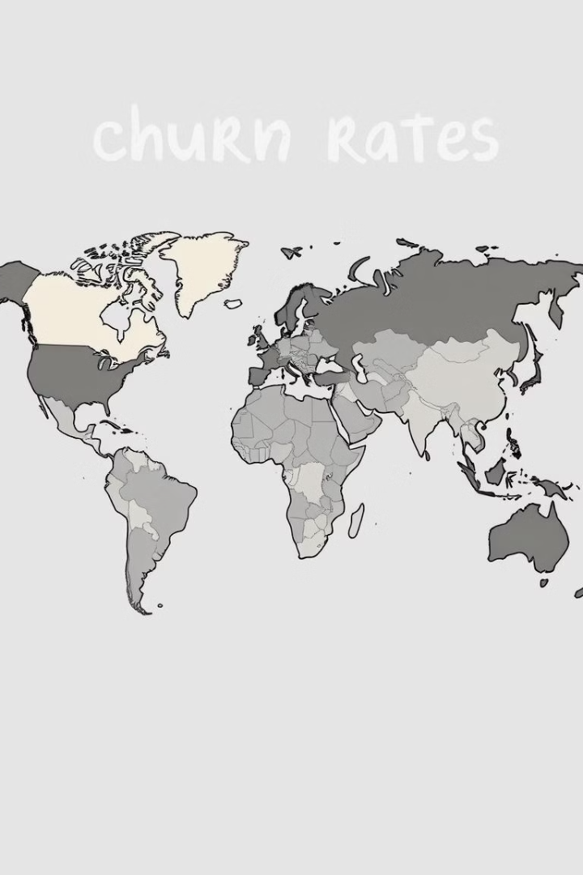
Regional Market Analysis
High Churn
Moderate Churn
Belgium, Chile, Denmark, Netherlands, Norway, and Spain have 100% churn rates.
Germany, Brazil, France, and the UK have mid-range churn rates.
Low Churn
The USA and Canada have strong customer retention, with
low churn rates.

Slide 11
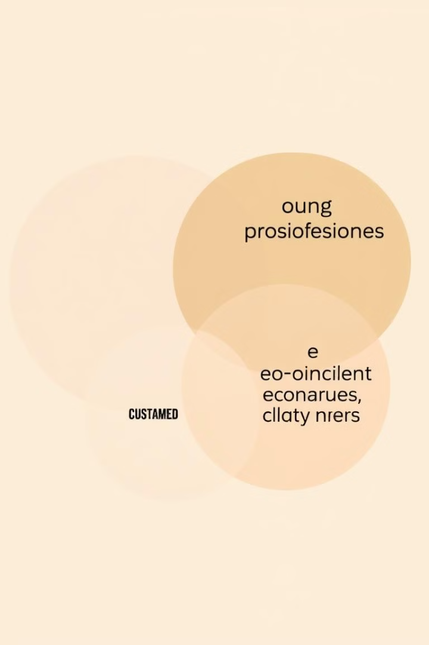


Customer Segmentation & Risk Profiling
High-Risk Customers
Low-Risk Customers
Customers in smaller markets with low total spend and high purchase frequency are more likely to churn.
Customers with higher total spend and frequent purchases are more stable and engaged, indicating better retention strategies.

Slide 12
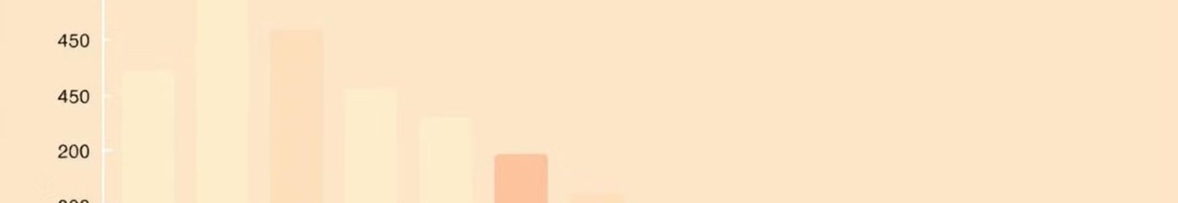



Regional Market Analysis
High Engagement
Czech Republic and Portugal have the highest average purchases per customer, suggesting strong customer engagement.
Moderate Engagement
Brazil and France also show solid purchasing activity, possibly due to market familiarity with the platform.
Low Engagement
Lower engagement in Argentina suggests weaker market penetration.

Slide 13



Customer Lifetime Value (CLV) Modelling
Moderate CLV
USA, Canada, UK, Germany, and Brazil have stable customers but some churn risk, with CLV around $80 and an average of 81 purchases per customer.
2
High CLV
Czech Republic, Ireland, India, and Portugal have higher CLV, higher average purchase count, and lower churn rates.
1
Low CLV
Belgium, Chile, Denmark, Netherlands, Norway, and Spain have 100% churn rates, indicating lower CLV and a common pattern of frequent small purchases.
3

Slide 14

Recommendations & Next Steps
1
Targeted Marketing
2
Customer Retention
Prioritize Rock music promotion globally, with a focus on Alternative & Punk in specific markets.
Implement loyalty programs, personalized recommendations, and reactivation campaigns.
3
Regional Strategies
Tailor marketing efforts to specific regions, considering local preferences and churn rates.

Slide 15

Key Takeaways & Next Steps
Chinook Music Store has a global reach, with strong market presence in North America and Europe. Rock music dominates sales worldwide, with a dedicated audience for niche genres like Jazz and Easy Listening. Customer purchasing behaviour varies by region, with high engagement in Czech Republic and Portugal and lower engagement in Argentina. Customer churn rates are highest in smaller markets, suggesting a need for localized promotions and stronger retention strategies. By leveraging customer data and insights, Chinook can optimize marketing efforts, personalize recommendations, and improve customer lifetime value.

Slide 16
Thank You

